Slide 1
Map and Compass Training (Navigation) Kevin Reilly, T1029 ASM

Slide 2
Mr. Bean and the Compass
https://youtu.be/pxseWKWlMVU

Slide 3
Rank Requirements
Second Class Requirements
3a: Demonstrate how a compass works and how to orient a map. Use a map to point out and tell the meaning of five map symbols.
First Class Requirements
4a: Using a map and compass, complete an orienteering course that covers at least one mile and requires measuring the height and/or width of designated items (tree, tower, canyon, ditch, etc.).

Slide 4
Training Agenda
What is a compass and how does it work
Parts of the compass
Determining Compass Bearing
What is a topographic map?
Symbols on a topographic map
Reading a contour map
Orienting a map with a compass
Determining Map Bearing

Slide 5
Training Agenda, continued
Translating True North to Magnetic North (Compass North)
Calculate the distance between points on a Map
What is a Pace Count?
Calculating Pace Count
Measuring Height
Orienteering Course for “in person” Scout Meeting
Build a route plan

Slide 6
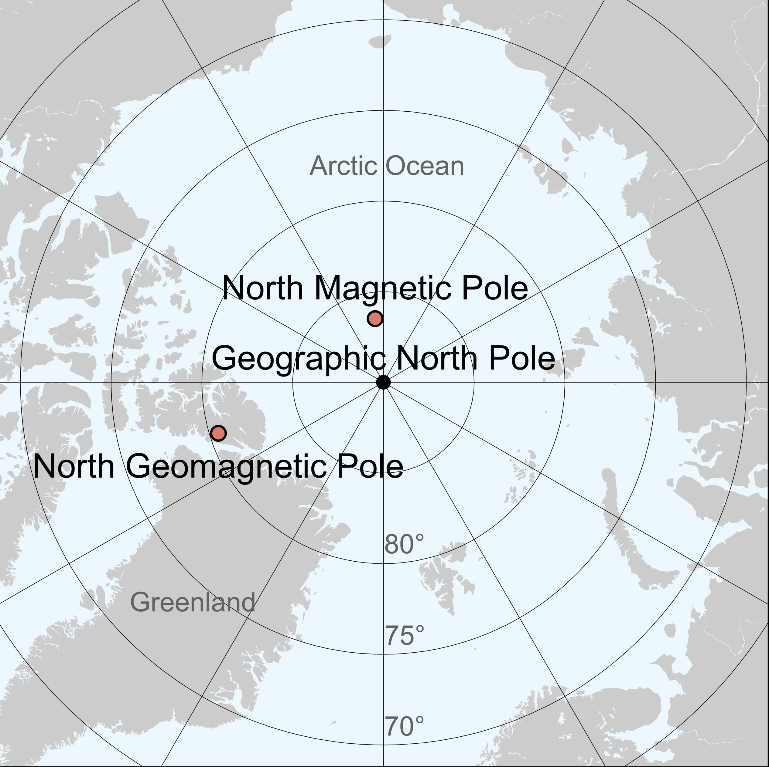
1. What is a Compass?
A compass is an instrument used for navigation and orientation that shows direction relative to the geographic cardinal directions. These cardinal directions are north, south, east, and west. The magnetic compass is the most common compass type. It functions as a pointer to “magnetic north” because its magnetized needle at aligns itself with the horizontal component of the Earth’s magnetic field. The magnetic field exerts a force on the needle, pulling it towards the Earth’s North magnetic pole. When the compass is held level, the needle turns until, it point north.
A magnetic compass does not point to True North!
Magnetic North Pole
True North Pole

Slide 7
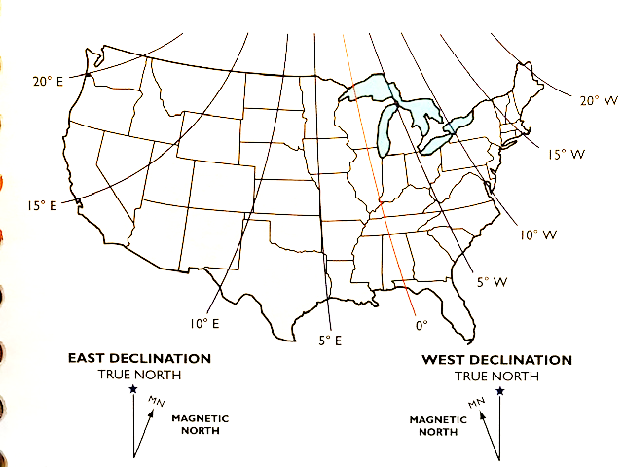
Adjusting for Declination
Declination is the angle between the magnetic north and true. This angle varies depending on position on the Earth's surface. Here in VA it is 10 W

Slide 8
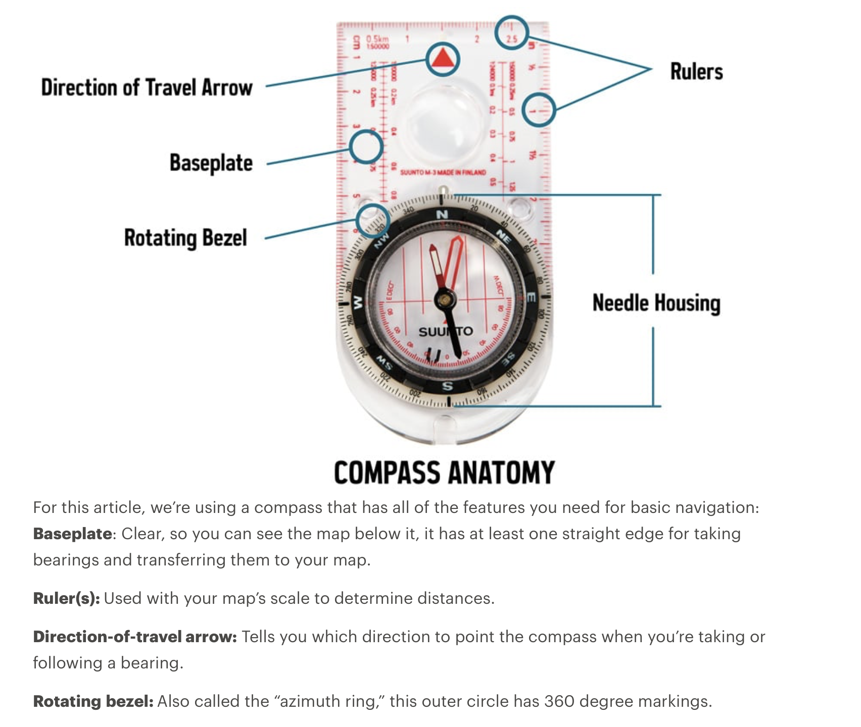
2. Parts of a Compass

Slide 9
2. Parts of a Compass

Slide 10
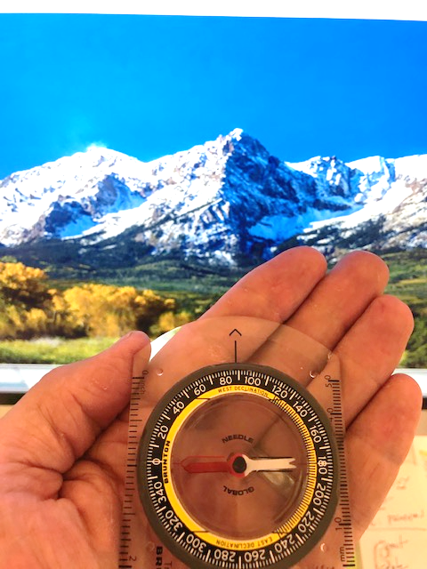
3. Taking a bearing
Keep the compass flat and point the “direction of travel arrow“ towards the terrain feature you want to get a bearing on.
Turn the bezel until the “orienting arrow” surrounds the magnetic needle.
Read the degrees off the bezel ring. In this case the magnetic bearing to the mountain is 88 degrees.
Remember, this is a magnetic bearing, it must be converted to true north bearing in order to use it on a map!

Slide 11
4. What is a topographic Map?
A topographic map is a type of map that provides a 2-dimensional representation of 3-dimensional terrain with the use of contour lines that connect points of equal elevation. Topographic maps also include symbols and colors to show both natural and artificial features.

Slide 12
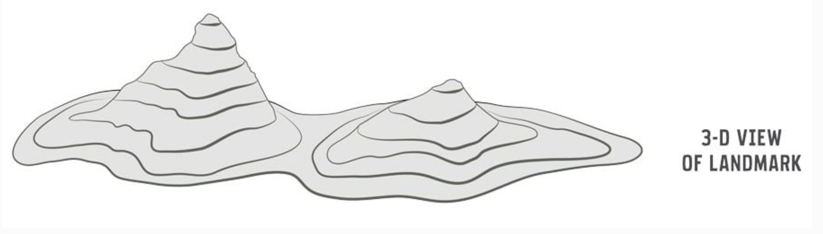
4. Topographic Map Concepts
Contour lines

Slide 13
4. Topographic Map Concepts
5. Symbols on a topographic map.

Slide 14
5. Topographic Map Symbols
5. Symbols on a topographic map.

Slide 15
5. Topographic Map Symbols

Slide 16
5. Topographic Map Symbols

Slide 17
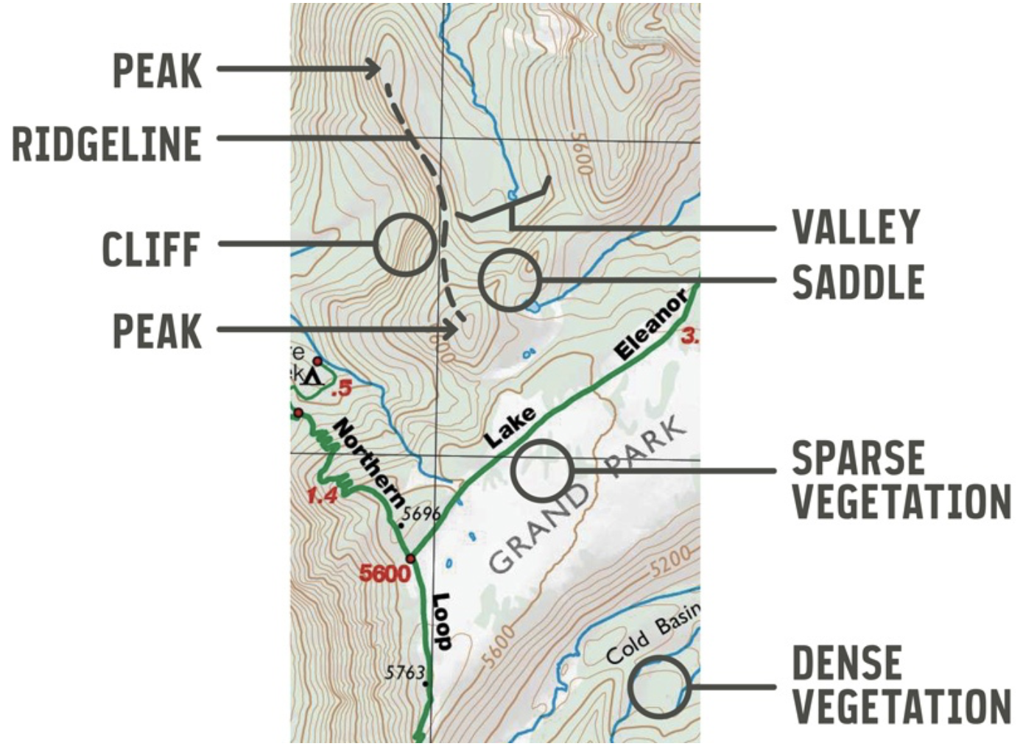
6. Reading a Topographic Map

Slide 18
7. Orienting a map with a compass
Align the orienting lines or edge of the compass with the north/south lines on the map.
Turn the map with the compass on it until the magnetized needle aligns with the orienting arrow.
The map is now generally oriented with the terrain.

Slide 19
8. Determining Map Bearing
Draw a line between the point you start at (point A) and the one you end up at (point B)
Align the compass on the line of travel between the 2 points.
Turn the bezel until the orienting arrow is parallel with the north/south longitude lines and pointing to true north. (ignore the magnetic needle!)
Read the degrees off the bezel ring where it intersects the line between point A and B. In this case approximately 70 degrees.

Slide 20
9. Translating Map Bearing to Magnetic Bearing
First locate the declination diagram on your map.
In this case the diagram indicates the magnetic north is 10 degrees west of True North.
Previously we calculated the Map Bearing to be 70 degrees. However, to convert this to Magnetic Bearing, we need to add 10 degrees since the magnetic needle will point 10 degrees west of true north. Thus, if we follow a magnetic bearing of 80 degrees we will follow the line between A an B. (If you fail to add the 10 degrees, you will end up to the left of the point where you are supposed to be!)

Slide 21
10. Calculate the distance between points on a map
Draw a line between the 2 points.
Using a piece of blank paper, position on end on the starting point and mark the paper where it intersects with the ending point.
Using the scale at the bottom of the map, measure the distance between the end of the paper and the mark that you made. ( remember to start measuring for the zero otherwise you will calculate the distance incorrectly!)
In this case the distance is approximately 375 meters.

Slide 22
11. What is Pace Count?
Pace count is the distance you walk in one pace. A Pace is considered each time your right foot touches the ground (start walking with your left foot). Our pace count tells us how many paces it takes to go 100 meters (or whatever the scale on your map is. If your map’s units of measure is in feet, yards or miles, you should get a different pace count for these units obviously meters will not work.)
We will do calculations to determine what the approximate distance of your pace is in order to determine ground distance when you go through the orienteering course.

Slide 23
12. Determining your pace distance
Measure out a distance of 100 meters.
Walk the 100 meter distance in a normal stride counting every right foot step. (record that number it is your pace count).
Walk back to your starting point in a normal stride counting every right foot step. (record that number)
Add your two pace counts together.
Divide 200 meters by the combined pace count.
Example
first 100 meter walk = 75 paces
Return 100 meter walk = 76 paces
75 + 76 = 151 paces
200 meters/151 paces = 1.3 meters / pace
Taking our previous map distance: 375 meters /1.3 meter/pace = 288.5 paces from point A to B

Slide 24
13. Measuring Height
Stick Method
Felling Method

Slide 25
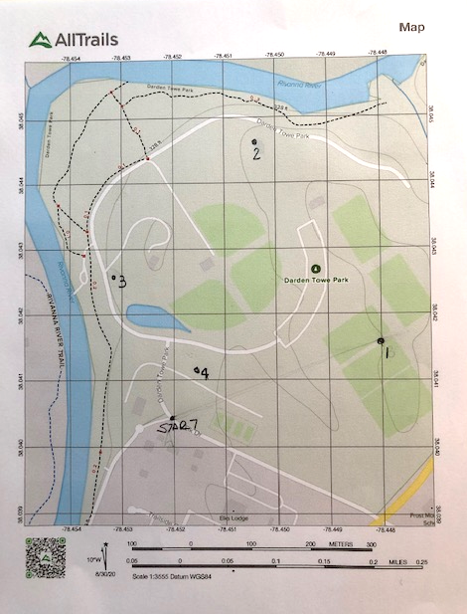
14. The orienteering course
Each scout’s course is different (don’t copy someone else’s work sheet or point letter because it will be different and you will get it marked wrong)
First you will calculate your pace count on a 100 meter course that we will mark out for you.
Next you will get a route map as shown to the right side.
From your route map, you will build a route plan and show it to an scout leader, the scout leader will ensure it is complete and will allow you to start your course.
Your departure time and completion time will be recorded.
After you finish you will be required to estimate the height of an object such as a light pole or tree.

Slide 26
15. Building a route plan
Route Plan
You will be given a map with a start point and several points for you to find.
Calculate the map bearing and distance between the points.
Convert the map bearing to magnetic bearing. Convert the map distance into paces.
Once those items are calculated, start your course.
As you find a point, record the letter on the stake located a your point.
Complete the course. Once you turn in your course sheet we will have you complete a height estimation. We will grade your sheet and tell you if you found the right points. The individual with the most correct points and fastest time will win the competition.
 | Map Bearing | Map Distance | Compass Distance | number of Paces | letter on point 1
Start to #1
#1 to #2
#2 to #3
#3 to #4

